Slide 1
Day 05
Horn's Method

Slide 2
Problem Statement
given n points measured in {L} and {R} estimate the transformation (or )
{L}
{R}

Slide 3
Problem Statement
given n points measured in {L} and {R}
find the transformation
residual errors
find the least-squares solution

Slide 4
1. Compute the Centroids
compute and subtract centroids from both sets of measurements

Slide 5
2. Compute the Matrix M
compute the sum of the component products for all pairs of corresponding points

Slide 6
3. Compute the Matrix N
use the elements of M to compute N
note that N is symmetric

Slide 7
4. Compute Eigenvectors and Eigenvalues
compute the eigenvectors and eigenvalues of N
in principle, the eigenvectors and eigenvalues can be found by finding the roots of a 4th order polynomial but numeric methods are easier
the fact that N is symmetric allows for efficient numeric eigenvalue/vector solvers
in Matlab
% D is a diagonal matrix of eigenvalues
% columns of V are the corresponding eigenvectors
[V, D] = eig(N);

Slide 8
5. Find the Quaternion
the quaternion representing the estimated rotation is the eigenvector corresponding to the largest positive eigenvalue
in Matlab
% y is the largest eigenvalue
% idx is the index of y in diag(D)
[y, idx] = max(diag(D));
Q = V(:, idx);

Slide 9
6. Compute the Translation
use the centroids to compute the estimated translation
recall that
using the centroids

Slide 10
Issues
the use of the least-squares criteria assumes
identically distributed noise in each point
isotropic noise in each point
more accurate (although more complicated) algorithms are available if these criteria are not met
Matei and Meer, IEEE PAMI, 28(10), Oct 2006

Slide 11
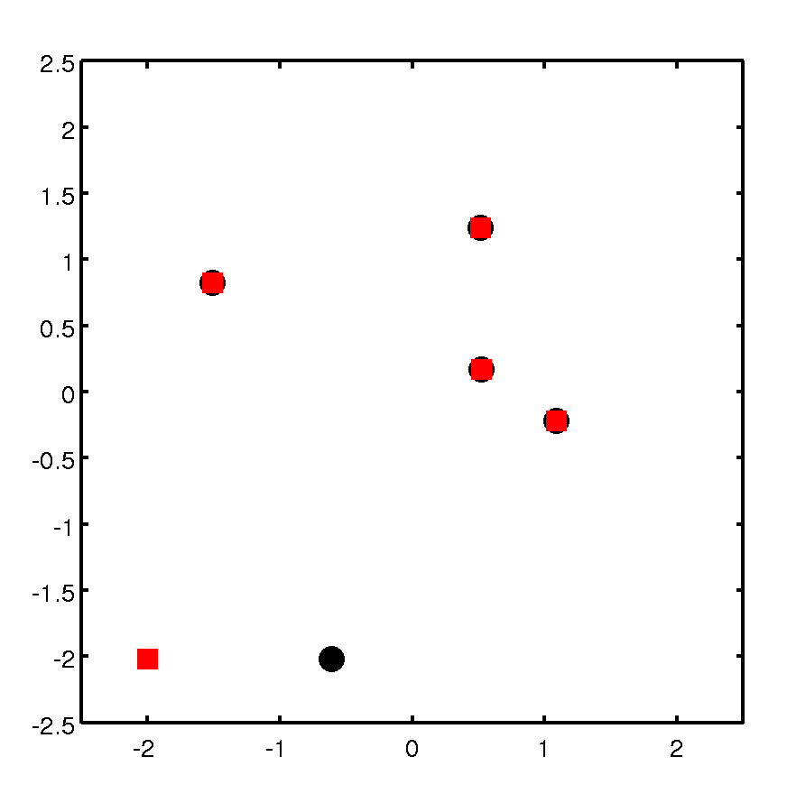
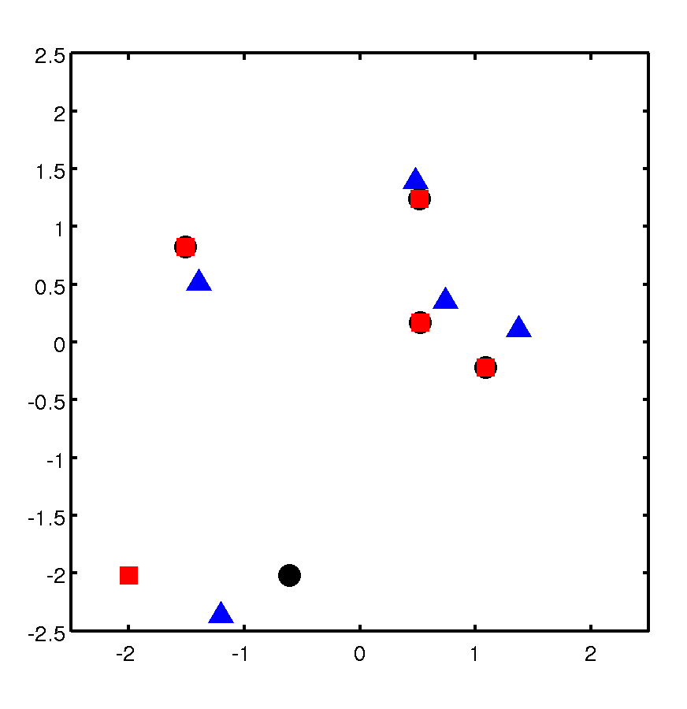
Issues
inaccurate measurements (statistical outliers) will lead to a poor estimate of the transformation
measured
registered

